Slide 1

DS201 – Introduction to Data Science
Final Data Project
Team ‘Survivors’
https://www.kaggle.com/datasets/usamabuttar/suicide-rates-worldwide.
LALITAAMBIGAI BALAKRISHNAN

Slide 2

Suicide Rate Worldwide
Lalitaambigai Balakrishnan

Slide 3


What is the dataset?
The dataset is a csv that contains suicide rate data for various countries and regions around the world from 2000 to 2019.
The dataset contains data on suicide rates for each year, including information on the country, location, year, sex, and estimated suicide rates with both upper and lower bounds.

Slide 4

What are we trying to find?
How have suicide rates changed over time globally and by region.
Anticipate proposition that the suicide rate among different gender ( Both Male and Female)
Which countries have the highest and lowest suicide rates, and how do these rates vary by demographic factors such as gender?
Are there any notable differences in suicide rates between urban and rural areas.
Approaches to prevent suicide worldwide?

Slide 5

BENEFITS OF THIS PROJECT
Improve understanding of suicide rates and trends
Identification of high-risk populations and regions
Evaluation of the effectiveness of prevention strategies.

Slide 6

DATA SOURCE;
The data was collected from the World Health Organization (WHO) Mortality Database, which provides information on deaths and mortality rates from various causes, including suicide.
https://www.kaggle.com/datasets/usamabuttar/suicide-rates-worldwide.

Slide 7

How did we clean the Data?
Explored the dataset and identify any missing, incorrect, or inconsistent data.
Clean the data by addressing any missing, incorrect, or inconsistent data. Some common data cleaning techniques include:
a) Handling missing data, to fill in missing data with a
specific value of method.
b) Removing duplicate data.
c) Handling inconsistent data.

Slide 8


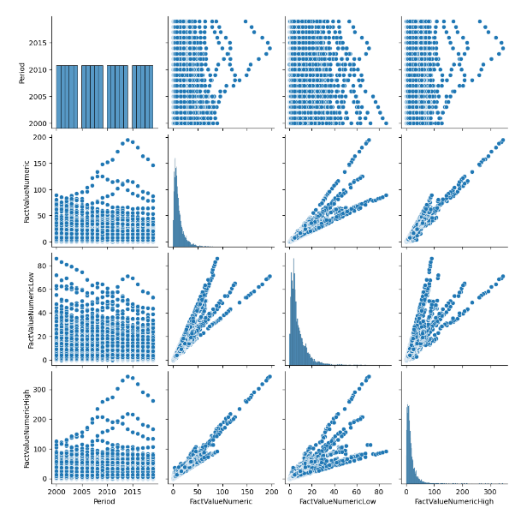
DATA ANALYSIS
Made a pairplot to help us understand the patterns and relationships in the data, which can inform the development of strategies and interventions to prevent suicide.

Slide 9

How the Suicidal Rate differs with the gender - We can clearly see that Male has higher suicidal rate than any gender from the year 2000-2019. Isn’t that shocking?

Slide 10
2000 WAS THE YEAR WITH HIGHEST RATE OF SUICIDE IN THE WORLD OF THE PERIOD BETWEEN 2000-2019

Slide 11
The Region of the world that has higher Suicidal……based on the countries

Slide 12

Hypotheses based on the Charts:
Male tend to take suicidal decision more than any gender. There could be many factors why that happens throughout the year.
The suicide rates tend to be higher in some regions such as Eastern Europe, and lower in others such as Central America and the Caribbean.

Slide 13
ANOMALIES
Some nations or areas have extremely high suicide rates, such as Greenland, Guyana, and Lithuania, while others have extremely low suicide rates, such as Jamaica, Antigua and Barbuda, and Barbados.
= To determine whether these extreme results are outliers or represent errors or other problems with the data, they should be investigated further.

Slide 14
IMPROVEMENT
One potential problem with this dataset is that it may not be comprehensive or up-to-date, as it only includes data up to 2016 and may not include all countries or regions.
To improve this dataset in the future, it would be useful to collect more up-to-date and comprehensive data on suicide rates, as well as to standardize data collection methods and definitions across different countries and regions.

Slide 15

THANK YOU ALL! ☺

